Slide 1
3D Transformation

Slide 2
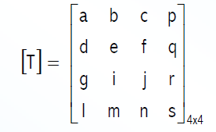
point in 3-D
A point in 3-D i.e., [x y z] is represented by a 4-dimensional position vector i.e.,
[x' y' z' h] = [x y z 1] [T]
The generalized 4x4 transformation matrix for 3-D homogeneous coordinates is

Slide 3
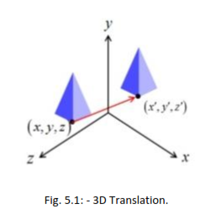
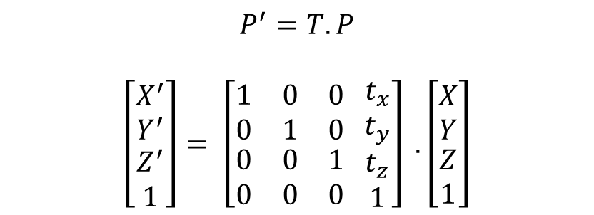
3 D translation
Similar to 2D translation, which used 3x3 matrices, 3D translation use 4X4 matrices (X, Y, Z, h).
In 3D translation point (X, Y, Z) is to be translated by amount t_{x}, t_{y} and t_{z} to location (X', Y', Z').
x’ = x + t_{x}
y’ = y + t_{y}
z’ = z + t_{z}
Let’s see matrix equation
$$P^{′}=T.P$$
$\left[\begin{matrix}\begin{aligned}X^{′} \\ Y^{′}\end{aligned} \\ Z^{′} \\ 1\end{matrix}\right]= \left[\begin{matrix}1 & 0 & 0 \\ 0 & 1 & 0 \\ \begin{aligned}0 \\ 0\end{aligned} & \begin{aligned}0 \\ 0\end{aligned} & \begin{aligned}1 \\ 0\end{aligned}\end{matrix}\begin{matrix}{ t}_{x} \\ t_{y} \\ \begin{aligned}t_{z} \\ 1\end{aligned}\end{matrix}\right] .\left[\begin{matrix}\begin{aligned}X \\ Y\end{aligned} \\ Z \\ 1\end{matrix}\right]$

Slide 4
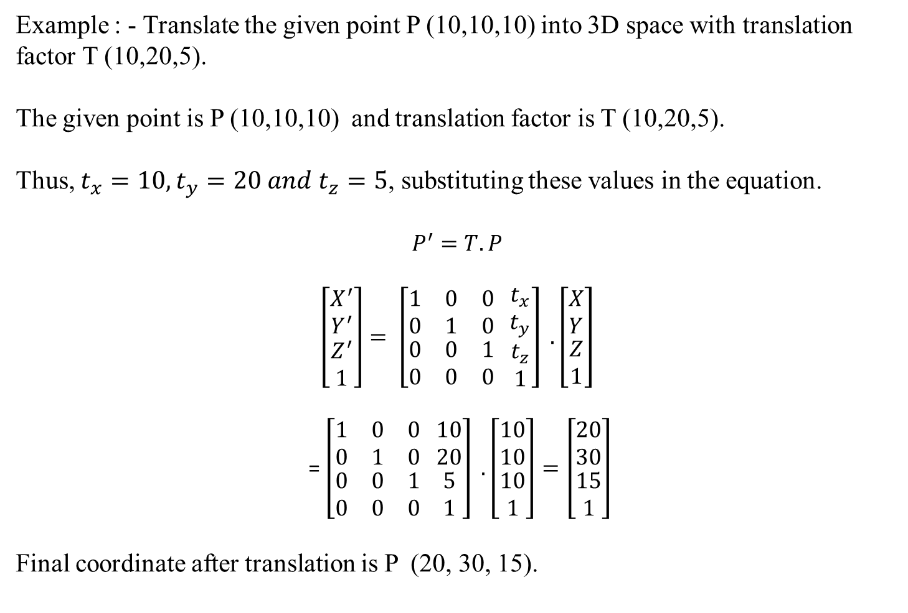
Example : - Translate the given point P (10,10,10) into 3D space with translation factor T (10,20,5).
The given point is P (10,10,10) and translation factor is T (10,20,5).
Thus, $t_{x}=10, t_{y}=20 and t_{z}=5$, substituting these values in the equation.
$$P^{′}=T.P$$
$\left[\begin{matrix}\begin{aligned}X^{′} \\ Y^{′}\end{aligned} \\ Z^{′} \\ 1\end{matrix}\right]= \left[\begin{matrix}1 & 0 & 0 \\ 0 & 1 & 0 \\ \begin{aligned}0 \\ 0\end{aligned} & \begin{aligned}0 \\ 0\end{aligned} & \begin{aligned}1 \\ 0\end{aligned}\end{matrix}\begin{matrix}{ t}_{x} \\ t_{y} \\ \begin{aligned}t_{z} \\ 1\end{aligned}\end{matrix}\right] .\left[\begin{matrix}\begin{aligned}X \\ Y\end{aligned} \\ Z \\ 1\end{matrix}\right]$
= $\left[\begin{matrix}1 & 0 & 0 \\ 0 & 1 & 0 \\ \begin{aligned}0 \\ 0\end{aligned} & \begin{aligned}0 \\ 0\end{aligned} & \begin{aligned}1 \\ 0\end{aligned}\end{matrix}\begin{matrix} 10 \\ 20 \\ \begin{aligned}5 \\ 1\end{aligned}\end{matrix}\right] .\left[\begin{matrix}\begin{aligned}10 \\ 10\end{aligned} \\ 10 \\ 1\end{matrix}\right]=\left[\begin{matrix}\begin{aligned}20 \\ 30\end{aligned} \\ 15 \\ 1\end{matrix}\right]$
Final coordinate after translation is P (20, 30, 15).

Slide 5
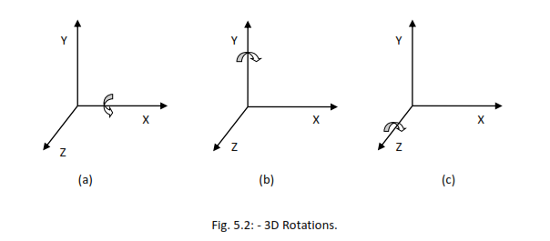
3 D Rotation
For 3D rotation we need to pick an axis to rotate about.
The most common choices are the X-axis, the Y-axis, and the Z-axis

Slide 6
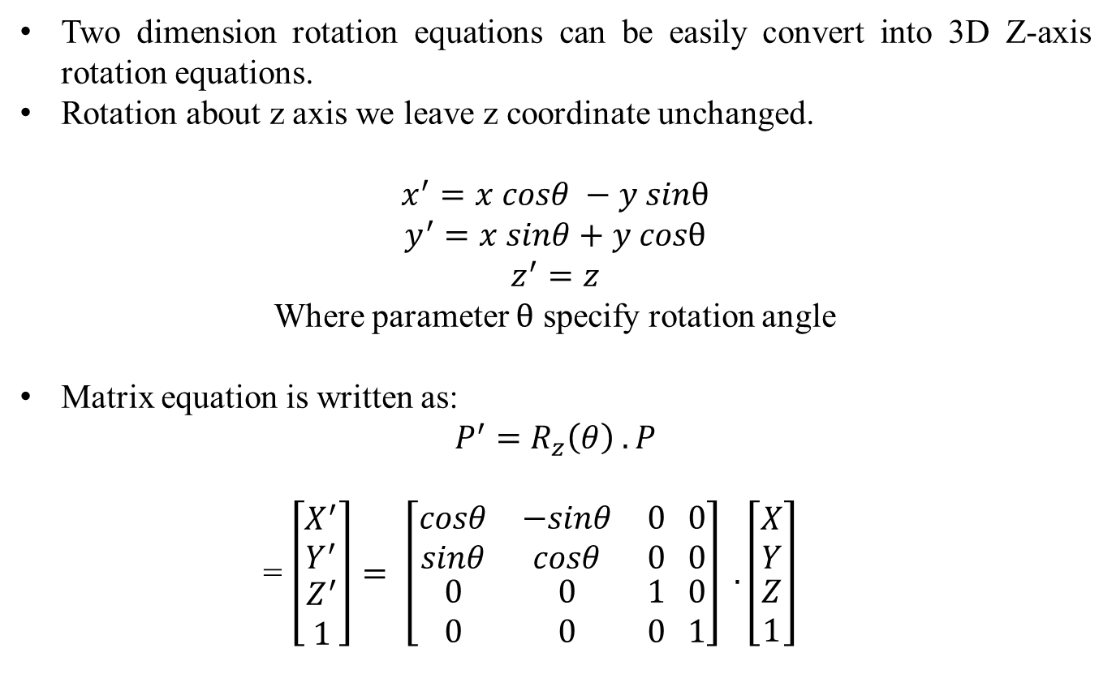
Z – axis rotation
Two dimension rotation equations can be easily convert into 3D Z-axis rotation equations.
Rotation about z axis we leave z coordinate unchanged.
$$x^{′}=x cosθ −y sinθ$$
$$y^{′}=x sinθ+y cosθ$$
$z^{′}=z$
Where parameter $θ$ specify rotation angle
Matrix equation is written as:
$$P^{′}=R_{z}\left(θ\right) . P$$
= $\left[\begin{matrix}\begin{aligned}X^{′} \\ Y^{′}\end{aligned} \\ Z^{′} \\ 1\end{matrix}\right]= \left[\begin{matrix}cosθ & −sinθ & 0 \\ sinθ & cosθ & 0 \\ \begin{aligned}0 \\ 0\end{aligned} & \begin{aligned}0 \\ 0\end{aligned} & \begin{aligned}1 \\ 0\end{aligned}\end{matrix}\begin{matrix} 0 \\ 0 \\ \begin{aligned}0 \\ 1\end{aligned}\end{matrix}\right] .\left[\begin{matrix}\begin{aligned}X \\ Y\end{aligned} \\ Z \\ 1\end{matrix}\right]$

Slide 7
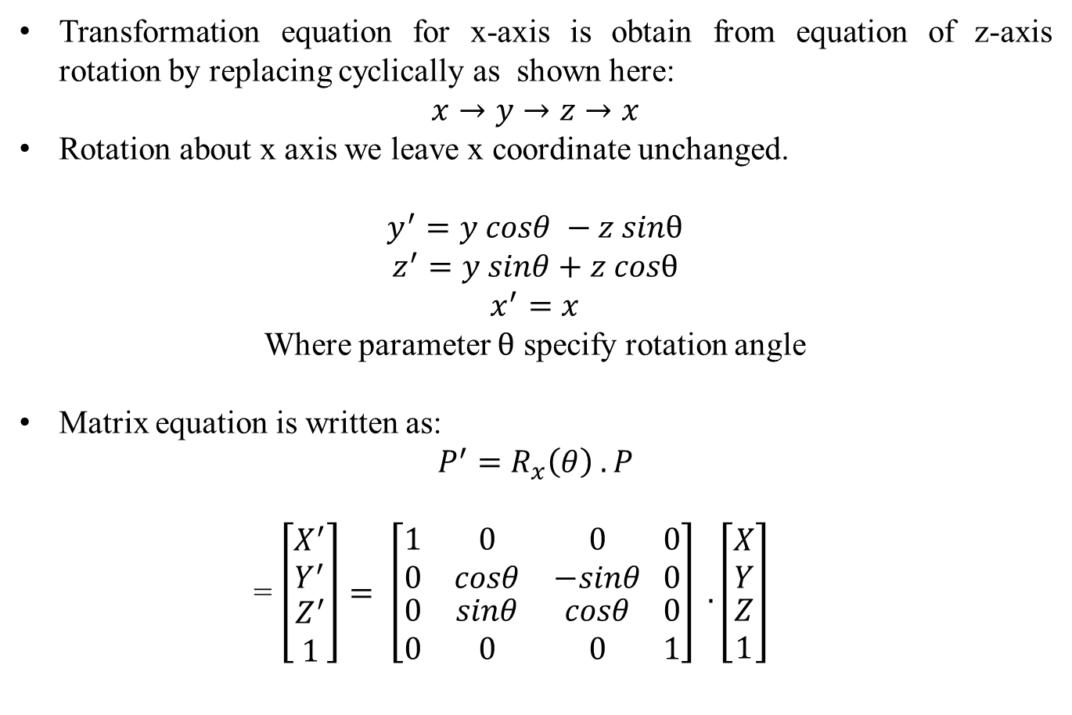
X – axis rotation
Transformation equation for x-axis is obtain from equation of z-axis rotation by replacing cyclically as shown here:
$$x→y→z→x$$
Rotation about x axis we leave x coordinate unchanged.
$$y^{′}=y cosθ −z sinθ$$
$$z^{′}=y sinθ+z cosθ$$
$x^{′}=x$
Where parameter $θ$ specify rotation angle
Matrix equation is written as:
$$P^{′}=R_{x}\left(θ\right) . P$$
= $\left[\begin{matrix}\begin{aligned}X^{′} \\ Y^{′}\end{aligned} \\ Z^{′} \\ 1\end{matrix}\right]= \left[\begin{matrix}1 & 0 & 0 \\ 0 & cosθ & −sinθ \\ \begin{aligned}0 \\ 0\end{aligned} & \begin{aligned}sinθ \\ 0\end{aligned} & \begin{aligned}cosθ \\ 0\end{aligned}\end{matrix}\begin{matrix} 0 \\ 0 \\ \begin{aligned}0 \\ 1\end{aligned}\end{matrix}\right] .\left[\begin{matrix}\begin{aligned}X \\ Y\end{aligned} \\ Z \\ 1\end{matrix}\right]$

Slide 8
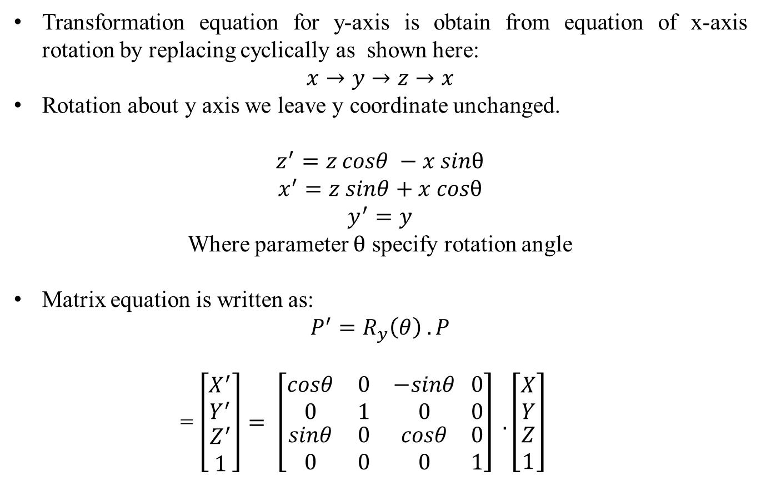
Y – axis rotation
Transformation equation for y-axis is obtain from equation of x-axis rotation by replacing cyclically as shown here:
$$x→y→z→x$$
Rotation about y axis we leave y coordinate unchanged.
$$z^{′}=z cosθ −x sinθ$$
$$x^{′}=z sinθ+x cosθ$$
$y^{′}=y$
Where parameter $θ$ specify rotation angle
Matrix equation is written as:
$$P^{′}=R_{y}\left(θ\right) . P$$
= $\left[\begin{matrix}\begin{aligned}X^{′} \\ Y^{′}\end{aligned} \\ Z^{′} \\ 1\end{matrix}\right]= \left[\begin{matrix}cosθ & 0 & −sinθ \\ 0 & 1 & 0 \\ \begin{aligned}sinθ \\ 0\end{aligned} & \begin{aligned}0 \\ 0\end{aligned} & \begin{aligned}cosθ \\ 0\end{aligned}\end{matrix}\begin{matrix} 0 \\ 0 \\ \begin{aligned}0 \\ 1\end{aligned}\end{matrix}\right] .\left[\begin{matrix}\begin{aligned}X \\ Y\end{aligned} \\ Z \\ 1\end{matrix}\right]$

Slide 9
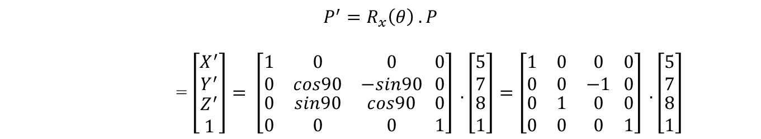
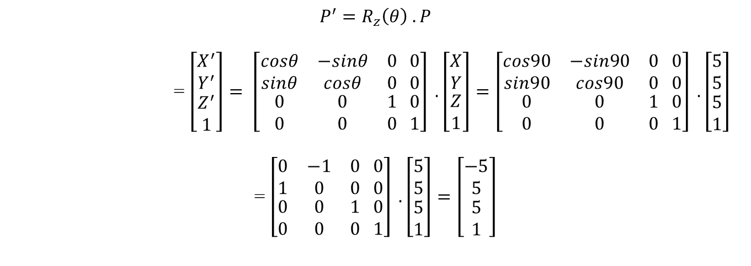
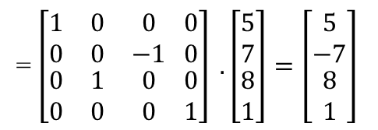
Example: - Rotate the point P(5,5,5), 90⁰ about Z axis.
$$P^{′}=R_{z}\left(θ\right) . P$$
= $\left[\begin{matrix}\begin{aligned}X^{′} \\ Y^{′}\end{aligned} \\ Z^{′} \\ 1\end{matrix}\right]= \left[\begin{matrix}cosθ & −sinθ & 0 \\ sinθ & cosθ & 0 \\ \begin{aligned}0 \\ 0\end{aligned} & \begin{aligned}0 \\ 0\end{aligned} & \begin{aligned}1 \\ 0\end{aligned}\end{matrix}\begin{matrix} 0 \\ 0 \\ \begin{aligned}0 \\ 1\end{aligned}\end{matrix}\right] .\left[\begin{matrix}\begin{aligned}X \\ Y\end{aligned} \\ Z \\ 1\end{matrix}\right]=\left[\begin{matrix}cos90 & −sin90 & 0 \\ sin90 & cos90 & 0 \\ \begin{aligned}0 \\ 0\end{aligned} & \begin{aligned}0 \\ 0\end{aligned} & \begin{aligned}1 \\ 0\end{aligned}\end{matrix}\begin{matrix} 0 \\ 0 \\ \begin{aligned}0 \\ 1\end{aligned}\end{matrix}\right] .\left[\begin{matrix}\begin{aligned}5 \\ 5\end{aligned} \\ 5 \\ 1\end{matrix}\right]$
= $\left[\begin{matrix}0 & −1 & 0 \\ 1 & 0 & 0 \\ \begin{aligned}0 \\ 0\end{aligned} & \begin{aligned}0 \\ 0\end{aligned} & \begin{aligned}1 \\ 0\end{aligned}\end{matrix}\begin{matrix} 0 \\ 0 \\ \begin{aligned}0 \\ 1\end{aligned}\end{matrix}\right] .\left[\begin{matrix}\begin{aligned}5 \\ 5\end{aligned} \\ 5 \\ 1\end{matrix}\right]=\left[\begin{matrix}\begin{aligned}−5 \\ 5\end{aligned} \\ 5 \\ 1\end{matrix}\right]$
Example: - Rotate the point P(5,7,8), 90⁰ about X axis.
$$P^{′}=R_{x}\left(θ\right) . P$$
= $\left[\begin{matrix}\begin{aligned}X^{′} \\ Y^{′}\end{aligned} \\ Z^{′} \\ 1\end{matrix}\right]= \left[\begin{matrix}1 & 0 & 0 \\ 0 & cos90 & −sin90 \\ \begin{aligned}0 \\ 0\end{aligned} & \begin{aligned}sin90 \\ 0\end{aligned} & \begin{aligned}cos90 \\ 0\end{aligned}\end{matrix}\begin{matrix} 0 \\ 0 \\ \begin{aligned}0 \\ 1\end{aligned}\end{matrix}\right] .\left[\begin{matrix}\begin{aligned}5 \\ 7\end{aligned} \\ 8 \\ 1\end{matrix}\right]=\left[\begin{matrix}1 & 0 & 0 \\ 0 & 0 & −1 \\ \begin{aligned}0 \\ 0\end{aligned} & \begin{aligned}1 \\ 0\end{aligned} & \begin{aligned}0 \\ 0\end{aligned}\end{matrix}\begin{matrix} 0 \\ 0 \\ \begin{aligned}0 \\ 1\end{aligned}\end{matrix}\right] .\left[\begin{matrix}\begin{aligned}5 \\ 7\end{aligned} \\ 8 \\ 1\end{matrix}\right]$
= $\left[\begin{matrix}1 & 0 & 0 \\ 0 & 0 & −1 \\ \begin{aligned}0 \\ 0\end{aligned} & \begin{aligned}1 \\ 0\end{aligned} & \begin{aligned}0 \\ 0\end{aligned}\end{matrix}\begin{matrix} 0 \\ 0 \\ \begin{aligned}0 \\ 1\end{aligned}\end{matrix}\right] .\left[\begin{matrix}\begin{aligned}5 \\ 7\end{aligned} \\ 8 \\ 1\end{matrix}\right]=\left[\begin{matrix}\begin{aligned}5 \\ −7\end{aligned} \\ 8 \\ 1\end{matrix}\right]$

Slide 10
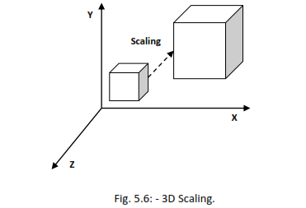
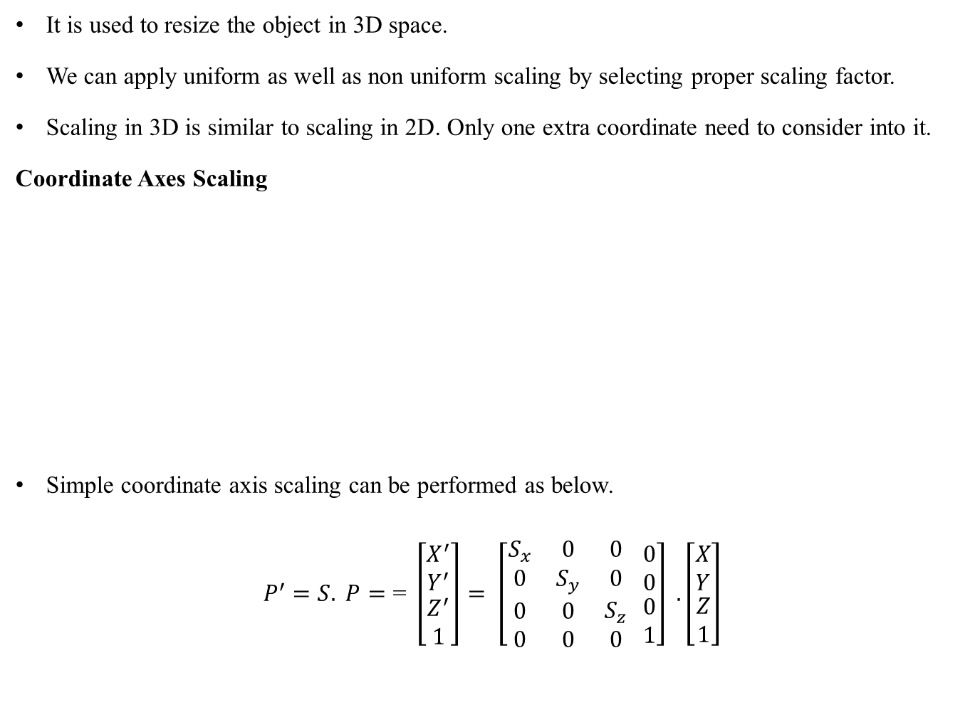
Scaling
It is used to resize the object in 3D space.
We can apply uniform as well as non uniform scaling by selecting proper scaling factor.
Scaling in 3D is similar to scaling in 2D. Only one extra coordinate need to consider into it.
Coordinate Axes Scaling
Simple coordinate axis scaling can be performed as below.
$$P^{′}=S. P=\text{= }\left[\begin{matrix}\begin{aligned}X^{′} \\ Y^{′}\end{aligned} \\ Z^{′} \\ 1\end{matrix}\right]= \left[\begin{matrix}S_{x} & 0 & 0 \\ 0 & S_{y} & 0 \\ \begin{aligned}0 \\ 0\end{aligned} & \begin{aligned}0 \\ 0\end{aligned} & \begin{aligned}S_{z} \\ 0\end{aligned}\end{matrix}\begin{matrix} 0 \\ 0 \\ \begin{aligned}0 \\ 1\end{aligned}\end{matrix}\right] .\left[\begin{matrix}\begin{aligned}X \\ Y\end{aligned} \\ Z \\ 1\end{matrix}\right]$$

Slide 11
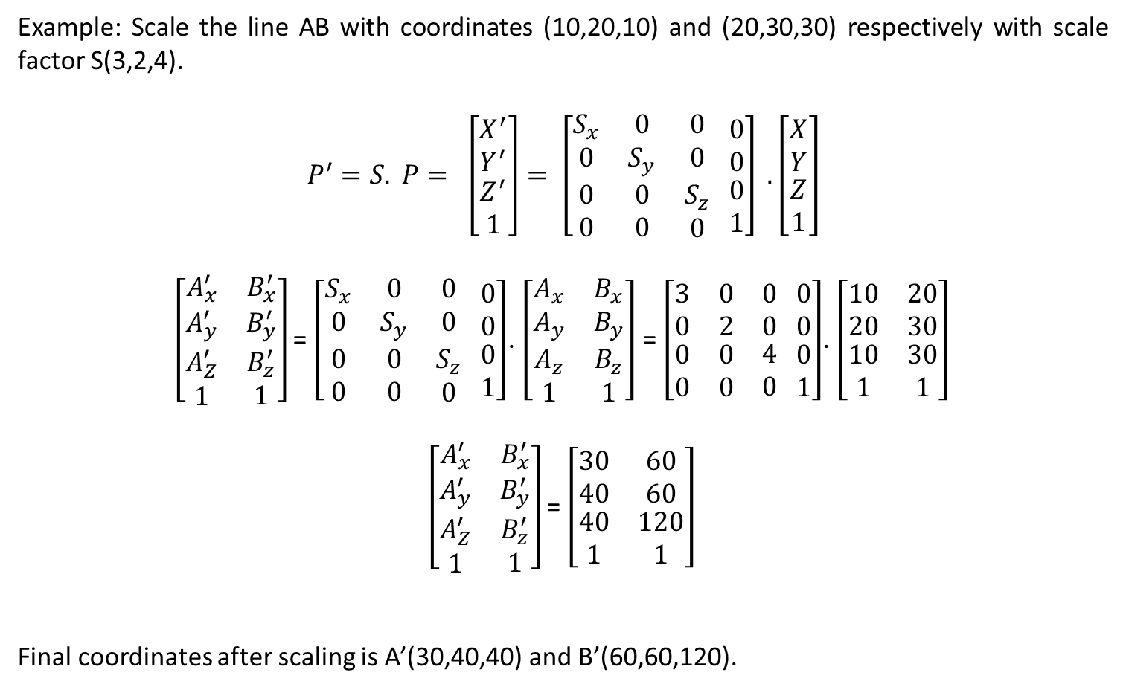
Example: Scale the line AB with coordinates (10,20,10) and (20,30,30) respectively with scale factor S(3,2,4).
$$P^{′}=S. P= \left[\begin{matrix}\begin{aligned}X^{′} \\ Y^{′}\end{aligned} \\ Z^{′} \\ 1\end{matrix}\right]= \left[\begin{matrix}S_{x} & 0 & 0 \\ 0 & S_{y} & 0 \\ \begin{aligned}0 \\ 0\end{aligned} & \begin{aligned}0 \\ 0\end{aligned} & \begin{aligned}S_{z} \\ 0\end{aligned}\end{matrix}\begin{matrix} 0 \\ 0 \\ \begin{aligned}0 \\ 1\end{aligned}\end{matrix}\right] .\left[\begin{matrix}\begin{aligned}X \\ Y\end{aligned} \\ Z \\ 1\end{matrix}\right]$$
$\left[\begin{matrix}A_{x}^{′} & B_{x}^{′} \\ A_{y}^{′} & B_{y}^{′} \\ \begin{aligned}A_{Z}^{′} \\ 1\end{aligned} & \begin{aligned}B_{z}^{′} \\ 1\end{aligned}\end{matrix}\right]$ = $\left[\begin{matrix}S_{x} & 0 & 0 \\ 0 & S_{y} & 0 \\ \begin{aligned}0 \\ 0\end{aligned} & \begin{aligned}0 \\ 0\end{aligned} & \begin{aligned}S_{z} \\ 0\end{aligned}\end{matrix}\begin{matrix} 0 \\ 0 \\ \begin{aligned}0 \\ 1\end{aligned}\end{matrix}\right]$. $\left[\begin{matrix}A_{x} & B_{x} \\ A_{y} & B_{y} \\ \begin{aligned}A_{z} \\ 1\end{aligned} & \begin{aligned}B_{z} \\ 1\end{aligned}\end{matrix}\right]$ = $\left[\begin{matrix}3 & 0 & 0 \\ 0 & 2 & 0 \\ \begin{aligned}0 \\ 0\end{aligned} & \begin{aligned}0 \\ 0\end{aligned} & \begin{aligned}4 \\ 0\end{aligned}\end{matrix}\begin{matrix} 0 \\ 0 \\ \begin{aligned}0 \\ 1\end{aligned}\end{matrix}\right]$. $\left[\begin{matrix}10 & 20 \\ 20 & 30 \\ \begin{aligned}10 \\ 1\end{aligned} & \begin{aligned}30 \\ 1\end{aligned}\end{matrix}\right]$
$\left[\begin{matrix}A_{x}^{′} & B_{x}^{′} \\ A_{y}^{′} & B_{y}^{′} \\ \begin{aligned}A_{Z}^{′} \\ 1\end{aligned} & \begin{aligned}B_{z}^{′} \\ 1\end{aligned}\end{matrix}\right]$ = $\left[\begin{matrix}30 & 60 \\ 40 & 60 \\ \begin{aligned}40 \\ 1\end{aligned} & \begin{aligned}120 \\ 1\end{aligned}\end{matrix}\right]$
Final coordinates after scaling is A’(30,40,40) and B’(60,60,120).

Slide 12
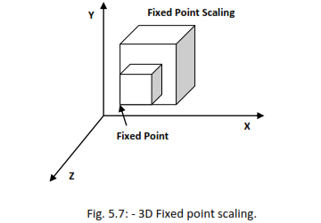
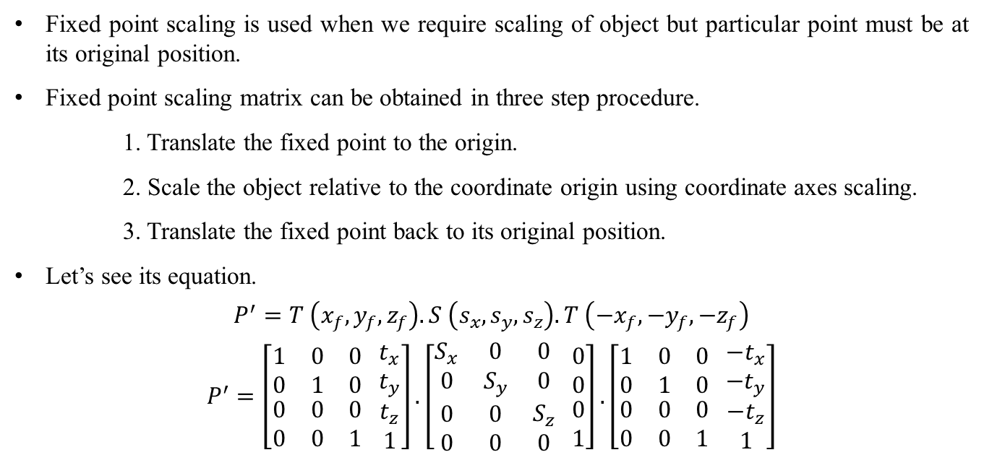
Fixed Point Scaling
Fixed point scaling is used when we require scaling of object but particular point must be at its original position.
Fixed point scaling matrix can be obtained in three step procedure.
1. Translate the fixed point to the origin.
2. Scale the object relative to the coordinate origin using coordinate axes scaling.
3. Translate the fixed point back to its original position.
Let’s see its equation.
$$P^{′}=T \left(x_{f}, y_{f}, z_{f}\right). S \left(s_{x}, s_{y}, s_{z}\right). T \left(−x_{f}, −y_{f}, −z_{f}\right)$$
$$P^{′}=\left[\begin{matrix}1 & 0 & 0 \\ 0 & 1 & 0 \\ \begin{aligned}0 \\ 0\end{aligned} & \begin{aligned}0 \\ 0\end{aligned} & \begin{aligned}0 \\ 1\end{aligned}\end{matrix}\begin{matrix}{ t}_{x} \\ t_{y} \\ \begin{aligned}t_{z} \\ 1\end{aligned}\end{matrix}\right].\left[\begin{matrix}S_{x} & 0 & 0 \\ 0 & S_{y} & 0 \\ \begin{aligned}0 \\ 0\end{aligned} & \begin{aligned}0 \\ 0\end{aligned} & \begin{aligned}S_{z} \\ 0\end{aligned}\end{matrix}\begin{matrix} 0 \\ 0 \\ \begin{aligned}0 \\ 1\end{aligned}\end{matrix}\right].\left[\begin{matrix}1 & 0 & 0 \\ 0 & 1 & 0 \\ \begin{aligned}0 \\ 0\end{aligned} & \begin{aligned}0 \\ 0\end{aligned} & \begin{aligned}0 \\ 1\end{aligned}\end{matrix}\begin{matrix}{ −t}_{x} \\ {−t}_{y} \\ \begin{aligned}{−t}_{z} \\ 1\end{aligned}\end{matrix}\right]$$

Slide 13
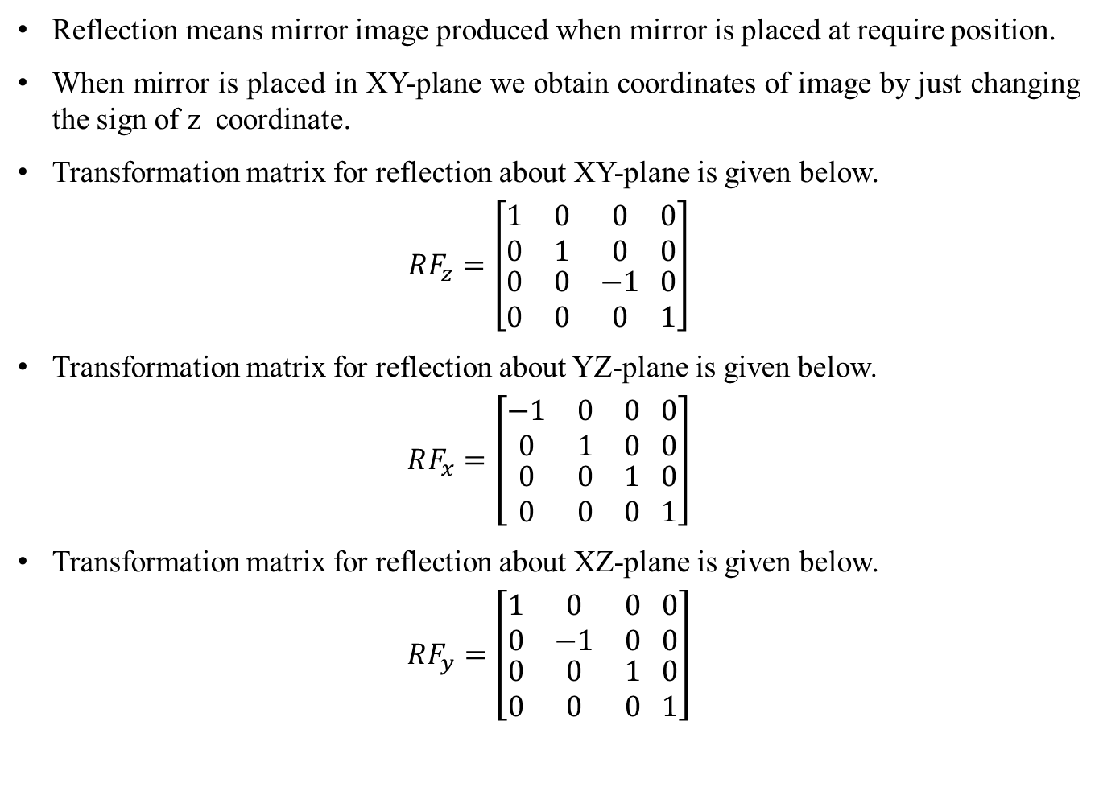
Reflection
Reflection means mirror image produced when mirror is placed at require position.
When mirror is placed in XY-plane we obtain coordinates of image by just changing the sign of z coordinate.
Transformation matrix for reflection about XY-plane is given below.
$$RF_{z}=\left[\begin{matrix}1 & 0 & 0 \\ 0 & 1 & 0 \\ \begin{aligned}0 \\ 0\end{aligned} & \begin{aligned}0 \\ 0\end{aligned} & \begin{aligned}−1 \\ 0\end{aligned}\end{matrix}\begin{matrix} 0 \\ 0 \\ \begin{aligned}0 \\ 1\end{aligned}\end{matrix}\right]$$
Transformation matrix for reflection about YZ-plane is given below.
$$RF_{x}=\left[\begin{matrix}−1 & 0 & 0 \\ 0 & 1 & 0 \\ \begin{aligned}0 \\ 0\end{aligned} & \begin{aligned}0 \\ 0\end{aligned} & \begin{aligned}1 \\ 0\end{aligned}\end{matrix}\begin{matrix} 0 \\ 0 \\ \begin{aligned}0 \\ 1\end{aligned}\end{matrix}\right]$$
Transformation matrix for reflection about XZ-plane is given below.
$$RF_{y}=\left[\begin{matrix}1 & 0 & 0 \\ 0 & −1 & 0 \\ \begin{aligned}0 \\ 0\end{aligned} & \begin{aligned}0 \\ 0\end{aligned} & \begin{aligned}1 \\ 0\end{aligned}\end{matrix}\begin{matrix} 0 \\ 0 \\ \begin{aligned}0 \\ 1\end{aligned}\end{matrix}\right]$$

Slide 14
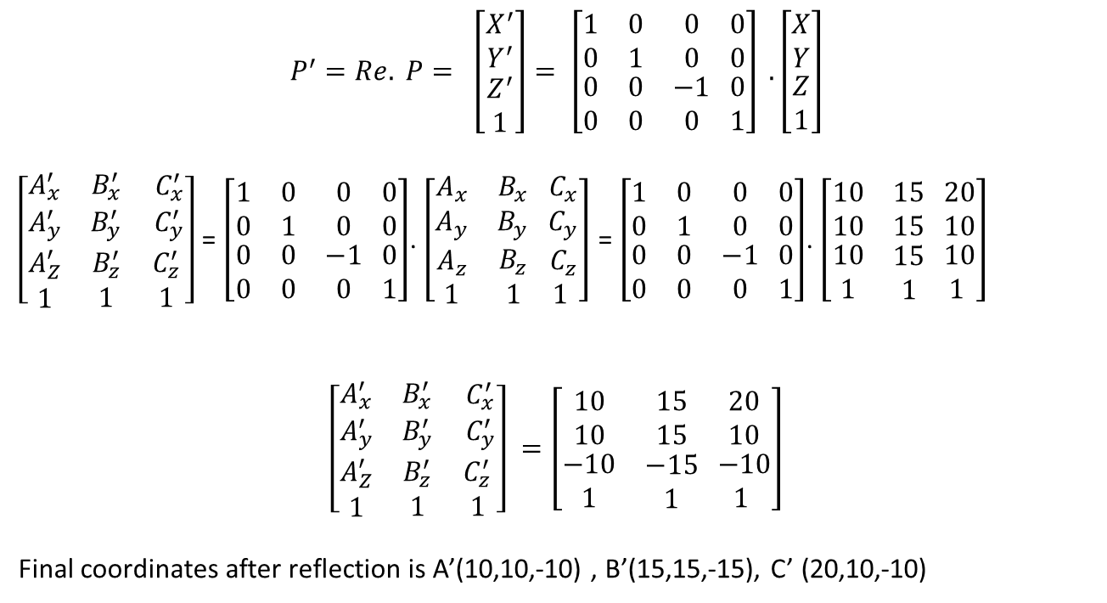
Example: - Find the coordinates after reflection of the triangle [A (10, 10, 10), B (15, 15, 15), C (20, 10, 10)] about XY plane.
$$P^{′}=Re. P= \left[\begin{matrix}\begin{aligned}X^{′} \\ Y^{′}\end{aligned} \\ Z^{′} \\ 1\end{matrix}\right]= \left[\begin{matrix}1 & 0 & 0 \\ 0 & 1 & 0 \\ \begin{aligned}0 \\ 0\end{aligned} & \begin{aligned}0 \\ 0\end{aligned} & \begin{aligned}−1 \\ 0\end{aligned}\end{matrix}\begin{matrix} 0 \\ 0 \\ \begin{aligned}0 \\ 1\end{aligned}\end{matrix}\right] .\left[\begin{matrix}\begin{aligned}X \\ Y\end{aligned} \\ Z \\ 1\end{matrix}\right]$$
$\left[\begin{matrix}A_{x}^{′} & B_{x}^{′} \\ A_{y}^{′} & B_{y}^{′} \\ \begin{aligned}A_{Z}^{′} \\ 1\end{aligned} & \begin{aligned}B_{z}^{′} \\ 1\end{aligned}\end{matrix}\begin{matrix}{ C}_{x}^{′} \\ { C}_{y}^{′} \\ \begin{aligned}{ C}_{z}^{′} \\ 1\end{aligned}\end{matrix}\right]$ = $\left[\begin{matrix}1 & 0 & 0 \\ 0 & 1 & 0 \\ \begin{aligned}0 \\ 0\end{aligned} & \begin{aligned}0 \\ 0\end{aligned} & \begin{aligned}−1 \\ 0\end{aligned}\end{matrix}\begin{matrix} 0 \\ 0 \\ \begin{aligned}0 \\ 1\end{aligned}\end{matrix}\right]$. $\left[\begin{matrix}A_{x} & B_{x} \\ A_{y} & B_{y} \\ \begin{aligned}A_{z} \\ 1\end{aligned} & \begin{aligned}B_{z} \\ 1\end{aligned}\end{matrix}\begin{matrix}{ C}_{x} \\ { C}_{y} \\ \begin{aligned}{ C}_{z} \\ 1\end{aligned}\end{matrix}\right]$ = $\left[\begin{matrix}1 & 0 & 0 \\ 0 & 1 & 0 \\ \begin{aligned}0 \\ 0\end{aligned} & \begin{aligned}0 \\ 0\end{aligned} & \begin{aligned}−1 \\ 0\end{aligned}\end{matrix}\begin{matrix} 0 \\ 0 \\ \begin{aligned}0 \\ 1\end{aligned}\end{matrix}\right]$. $\left[\begin{matrix}10 & 15 \\ 10 & 15 \\ \begin{aligned}10 \\ 1\end{aligned} & \begin{aligned}15 \\ 1\end{aligned}\end{matrix}\begin{matrix} 20 \\ 10 \\ \begin{aligned} 10 \\ 1\end{aligned}\end{matrix}\right]$
$$\left[\begin{matrix}A_{x}^{′} & B_{x}^{′} \\ A_{y}^{′} & B_{y}^{′} \\ \begin{aligned}A_{Z}^{′} \\ 1\end{aligned} & \begin{aligned}B_{z}^{′} \\ 1\end{aligned}\end{matrix}\begin{matrix}{ C}_{x}^{′} \\ { C}_{y}^{′} \\ \begin{aligned}{ C}_{z}^{′} \\ 1\end{aligned}\end{matrix}\right] =\left[\begin{matrix}10 & 15 \\ 10 & 15 \\ \begin{aligned}−10 \\ 1\end{aligned} & \begin{aligned}−15 \\ 1\end{aligned}\end{matrix}\begin{matrix} 20 \\ 10 \\ \begin{aligned} −10 \\ 1\end{aligned}\end{matrix}\right]$$
Final coordinates after reflection is A’(10,10,-10) , B’(15,15,-15), C’ (20,10,-10)

Slide 15
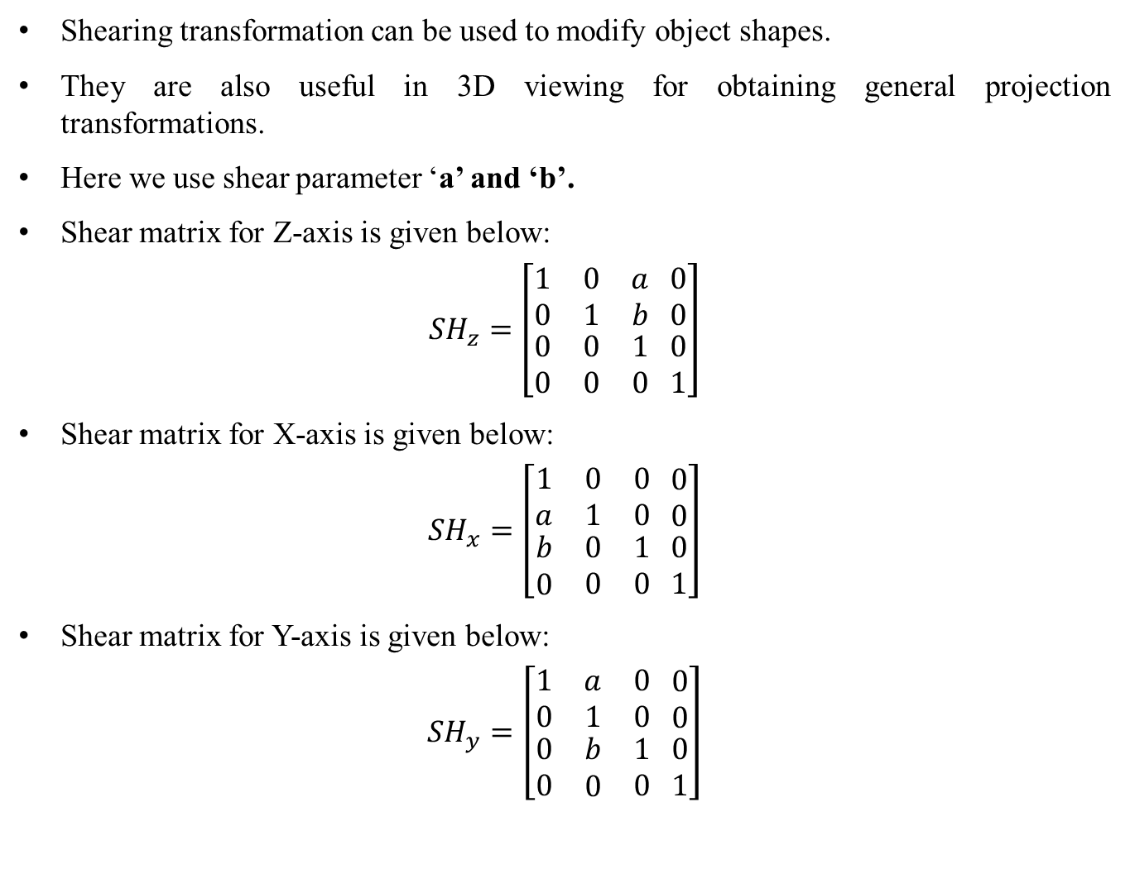
Shearing
Shearing transformation can be used to modify object shapes.
They are also useful in 3D viewing for obtaining general projection transformations.
Here we use shear parameter ‘a’ and ‘b’.
Shear matrix for Z-axis is given below:
$${SH}_{z}=\left[\begin{matrix}1 & 0 & a \\ 0 & 1 & b \\ \begin{aligned}0 \\ 0\end{aligned} & \begin{aligned}0 \\ 0\end{aligned} & \begin{aligned}1 \\ 0\end{aligned}\end{matrix}\begin{matrix} 0 \\ 0 \\ \begin{aligned}0 \\ 1\end{aligned}\end{matrix}\right]$$
Shear matrix for X-axis is given below:
$${SH}_{x}=\left[\begin{matrix}1 & 0 & 0 \\ a & 1 & 0 \\ \begin{aligned}b \\ 0\end{aligned} & \begin{aligned}0 \\ 0\end{aligned} & \begin{aligned}1 \\ 0\end{aligned}\end{matrix}\begin{matrix} 0 \\ 0 \\ \begin{aligned}0 \\ 1\end{aligned}\end{matrix}\right]$$
Shear matrix for Y-axis is given below:
$${SH}_{y}=\left[\begin{matrix}1 & a & 0 \\ 0 & 1 & 0 \\ \begin{aligned}0 \\ 0\end{aligned} & \begin{aligned}b \\ 0\end{aligned} & \begin{aligned}1 \\ 0\end{aligned}\end{matrix}\begin{matrix} 0 \\ 0 \\ \begin{aligned}0 \\ 1\end{aligned}\end{matrix}\right]$$

Slide 16
3-D Reflection
In 3-D, reflection occurs through a plane. But in 2-D, reflection occurs through an axis.
Transformation matrix for reflection through the xy-plane is -
Transformation matrix for reflection through yz-plane is –
Transformation matrix for reflection through the xz-plane is-

